Slide 1
Higher Order Functions
Functions that Work with Functions

Slide 2
What is a higher order functions?
A higher-order function in JavaScript is simply a function that:
Takes another function as an argument, or
Returns a function.
So, a higher-order function is a function that can work with other functions, either by using them or giving new ones back.

Slide 3
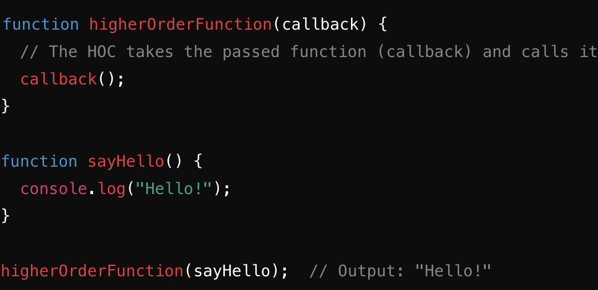
Higher order function syntax taking function as an argument
Syntax:
Declare a higher order function
The argument is function
A callback function is simply a function that is passed as an argument to another function and is executed at a later time, typically after some operation or event has completed.
The function returns the function, or it can return something else
We call the higher order function and pass it a function called sayHello. This will return the string ‘Hello’

Slide 4
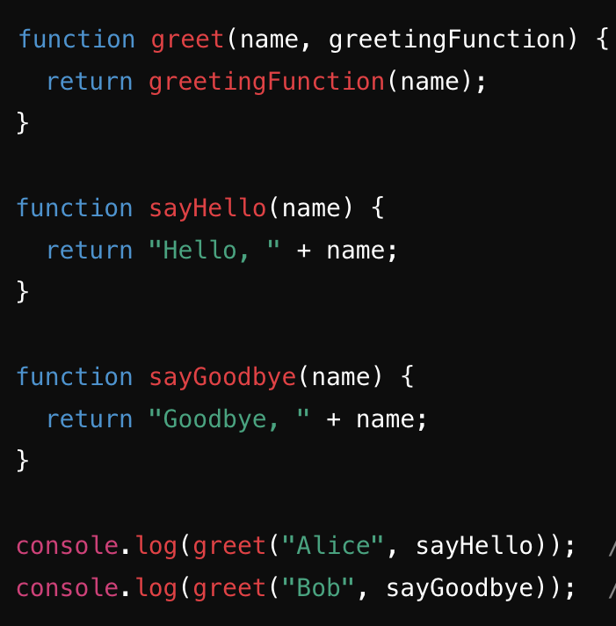
Example
Let’s walk through what is happening here:
Declare a HOF
Declare two more functions
Call the HOF and pass a name that’s a string as the first argument, and one of the functions as the second.
What will be the output of each console.log?

Slide 5
Practice:
Problem: Write a higher-order function (HOF) that takes two arguments:
A number
A function that performs a specific calculation on the number (e.g., doubling it, adding 2, multiplying it by another number, etc.).
You should:
Define the HOF that accepts the number and the calculation function as parameters.
Define one or more calculation functions (such as multiplyByTwo, addTwo, etc.).
Call the HOF, passing a number and one of the calculation functions you created.
Example of syntax:

Slide 6
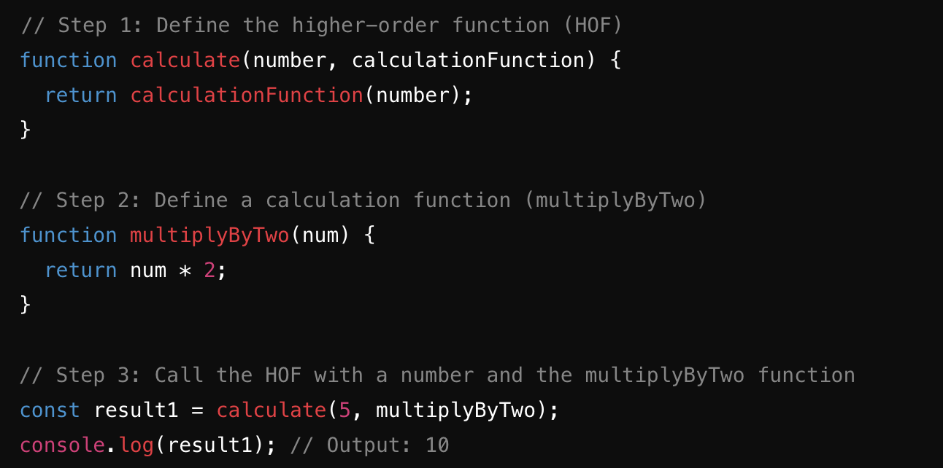
Examples:
Ex1: HOF(5, multiplyByTwo) should return 10

Slide 7
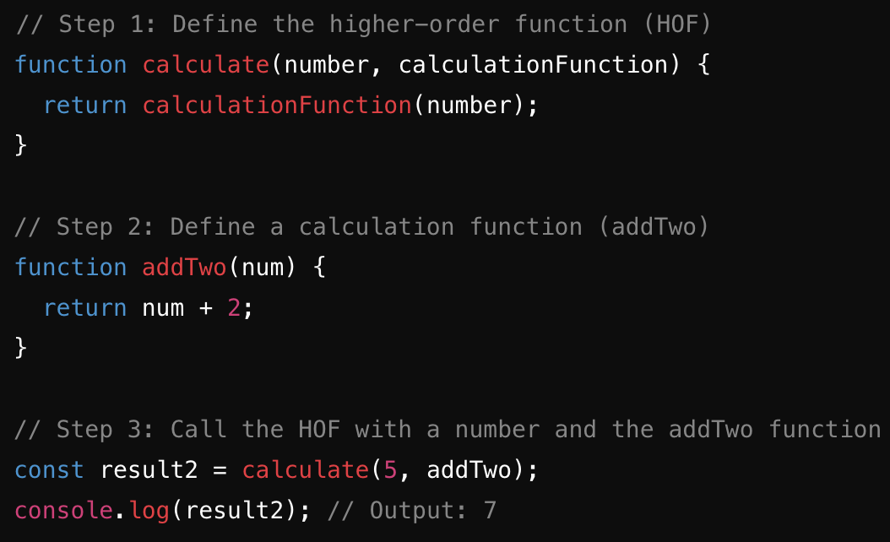
Ex2:HOF(5, addTwo) should return 7

Slide 8
Higher order function returning a function
Syntax:

